Slide 1
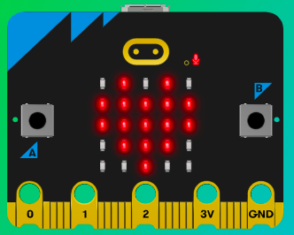
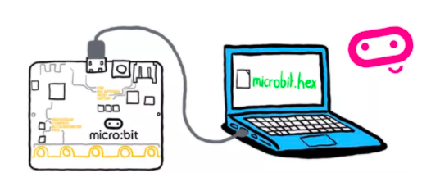
MicroMakers!
KIDS’ MAKER CLUB OF WASHINGTON, DC
Meet Up #10
And Now for Something Completely Different…

Slide 2
RECAP!
Inputs, Outputs, Processor
Micro:bit Inputs and Outputs
Scratch Inputs and Outputs
If, Then, Else
Variable
Loop
Bells and Whistles
Notes:
LEDs, Buttons, Light Sensor

Slide 3

SCRATCH!
The First Drag + Drop Visual Coding Language for Kids

Slide 4
CLOSE YOUR COMPUTERS!
We know you can’t wait to get started…but listen up!

Slide 5
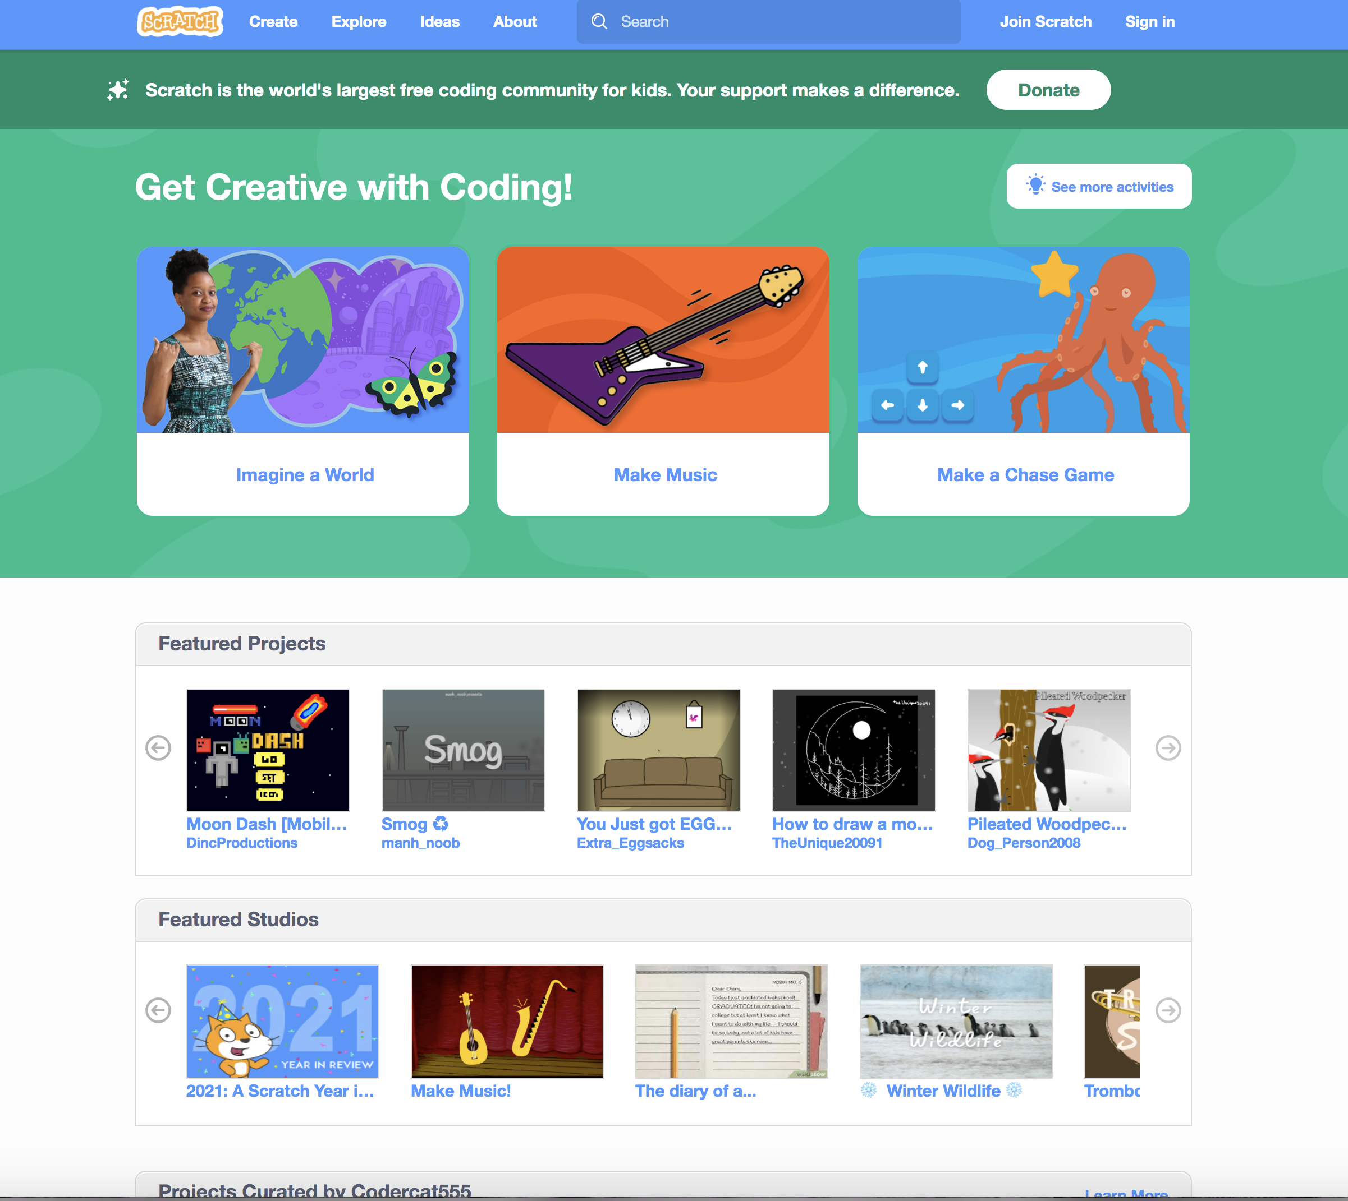
What do Kids Make with Scratch?

Slide 6
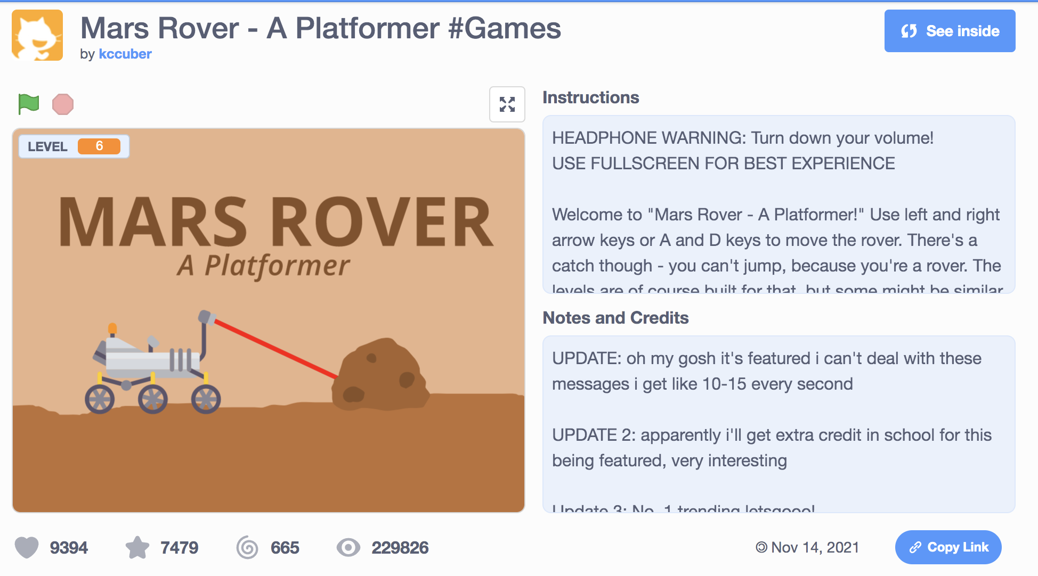
What do Kids Make with Scratch?

Slide 7
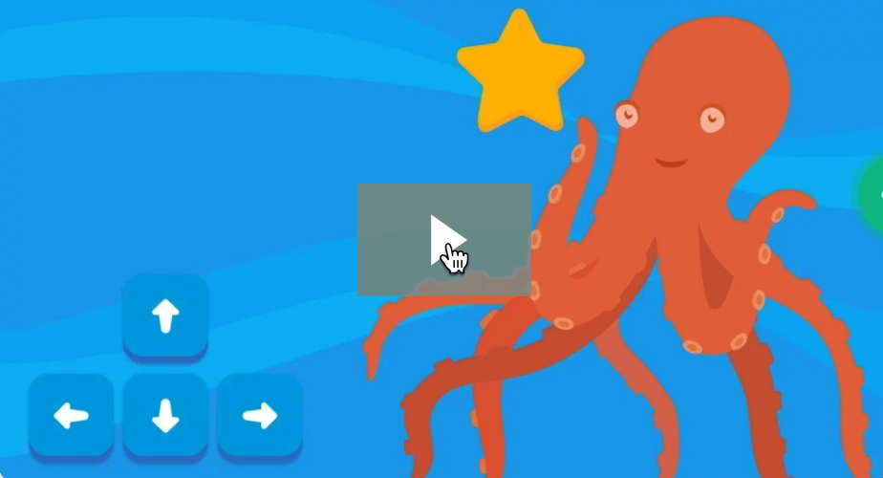
Step 1: The Project Chase Game!
What is it?
Create an interactive chase game.
What do I need?
Scratch coding environment.

Slide 8
Step 2: How Does it Work?
First, select a Backdrop for your program.
Then, click Create, to create a new ”sprite” using the Sprite Library. This is your chaser.
Next, make your sprite move in the correct direction when the user presses the arrow keys.
Add another sprite and make it move randomly when the program is started.
When your chaser touches the second sprite, have your program play a sound.
Create a score VARIABLE.
When chaser touches your sprite, add 1 to the score variable.

Slide 9


Step 2: How Does it Work?
Scratch is a super fun coding platform, with which you can do lots of neat things. PLEASE DO NOT GET DISTRACTED and try to finish this assignment, as given.
A good coder keeps their eye on the prize and completes a program’s key functions before adding what we call bells and whistles.

Slide 10
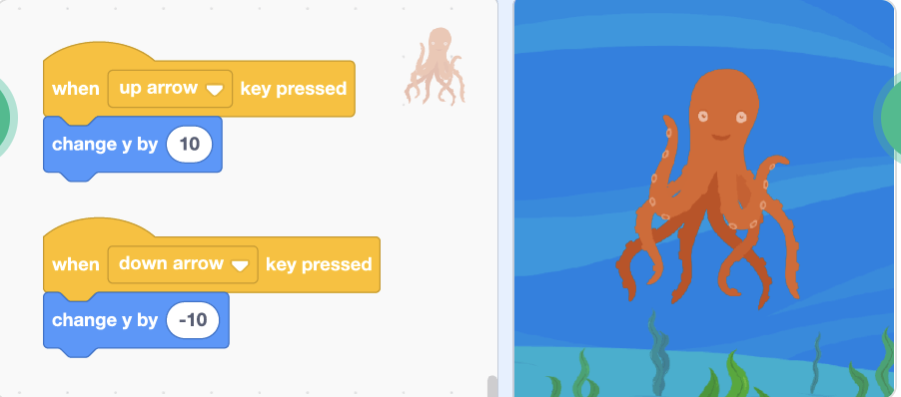
Step 3: Read It and Code It

Slide 11
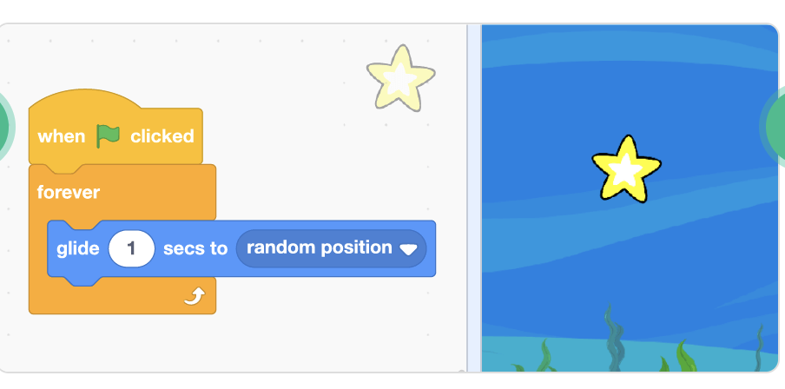
Step 3: Read It and Code It

Slide 12
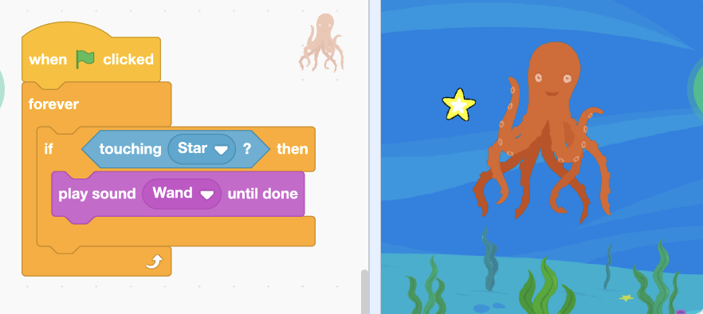
Step 3: Read It and Code It

Slide 13
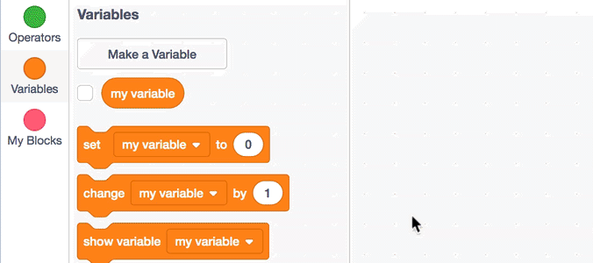
Step 3: Read It and Code It

Slide 14
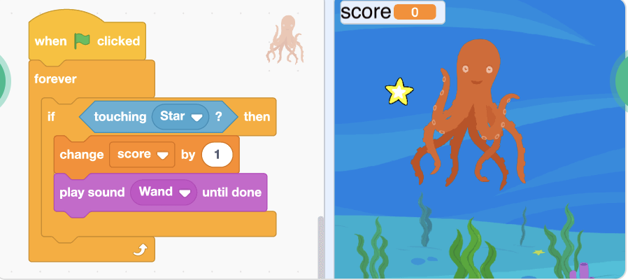
Step 3: Read It and Code It

Slide 15
Step 4: Share Your Creation!

Slide 16
Step 5: Improve It
Ask your clubmates for recommendations to improve your program and implement one of them.
Add your BELLS AND WHISTLES!!!

Slide 17
TIME TO PUT AWAY OUR COMPUTERS!
Neat and tidy, please!
Let’s leave this beautiful room as lovely as we found it!

Slide 18

UNTIL NEXT TIME….
MicroMakers!
Slides and Script: Holly Krambeck (learningpython64@gmail.com)
Project Videos, Images, and Text:
https://scratch.mit.edu/

